Slide 1


Differences in neural representative patterns between adults and children using naturalistic stimuli
Presented By:
William Mitchell
Notes:
Hi everybody Thank you so much for having me. My name is Billy Mitchell and I'm a graduate student in the Social and Affective Neuroscience lab at Temple.

Slide 2
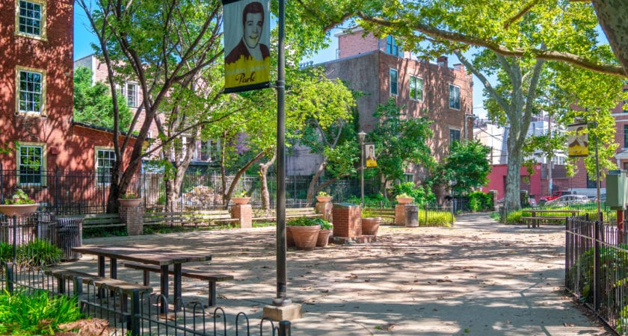
Notes:
And I always have a hard time figuring out how I want to start presentations
but working in noisy places usually helps me concentrate, so when I was agonizing over how I wanted to start this talk, I figured I’d try going park near where I live in Philadelphia to work it out

Slide 3







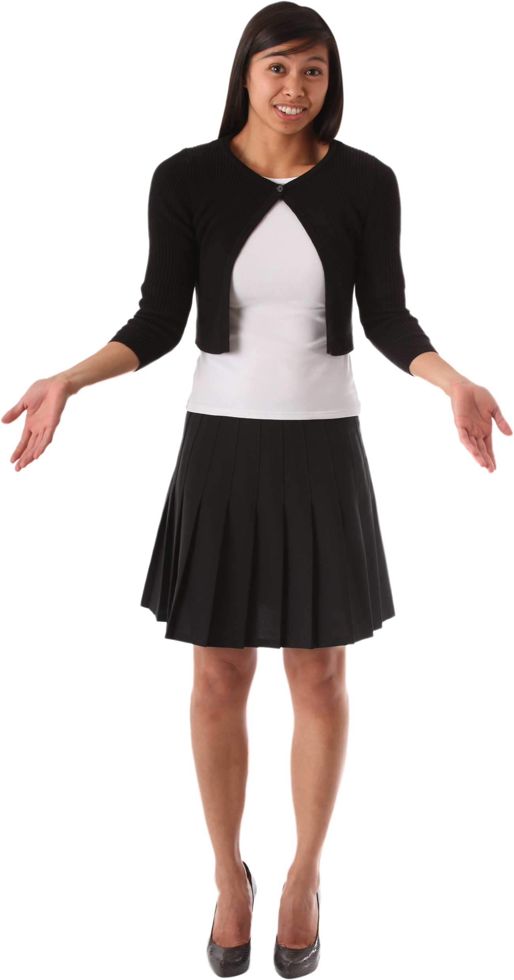
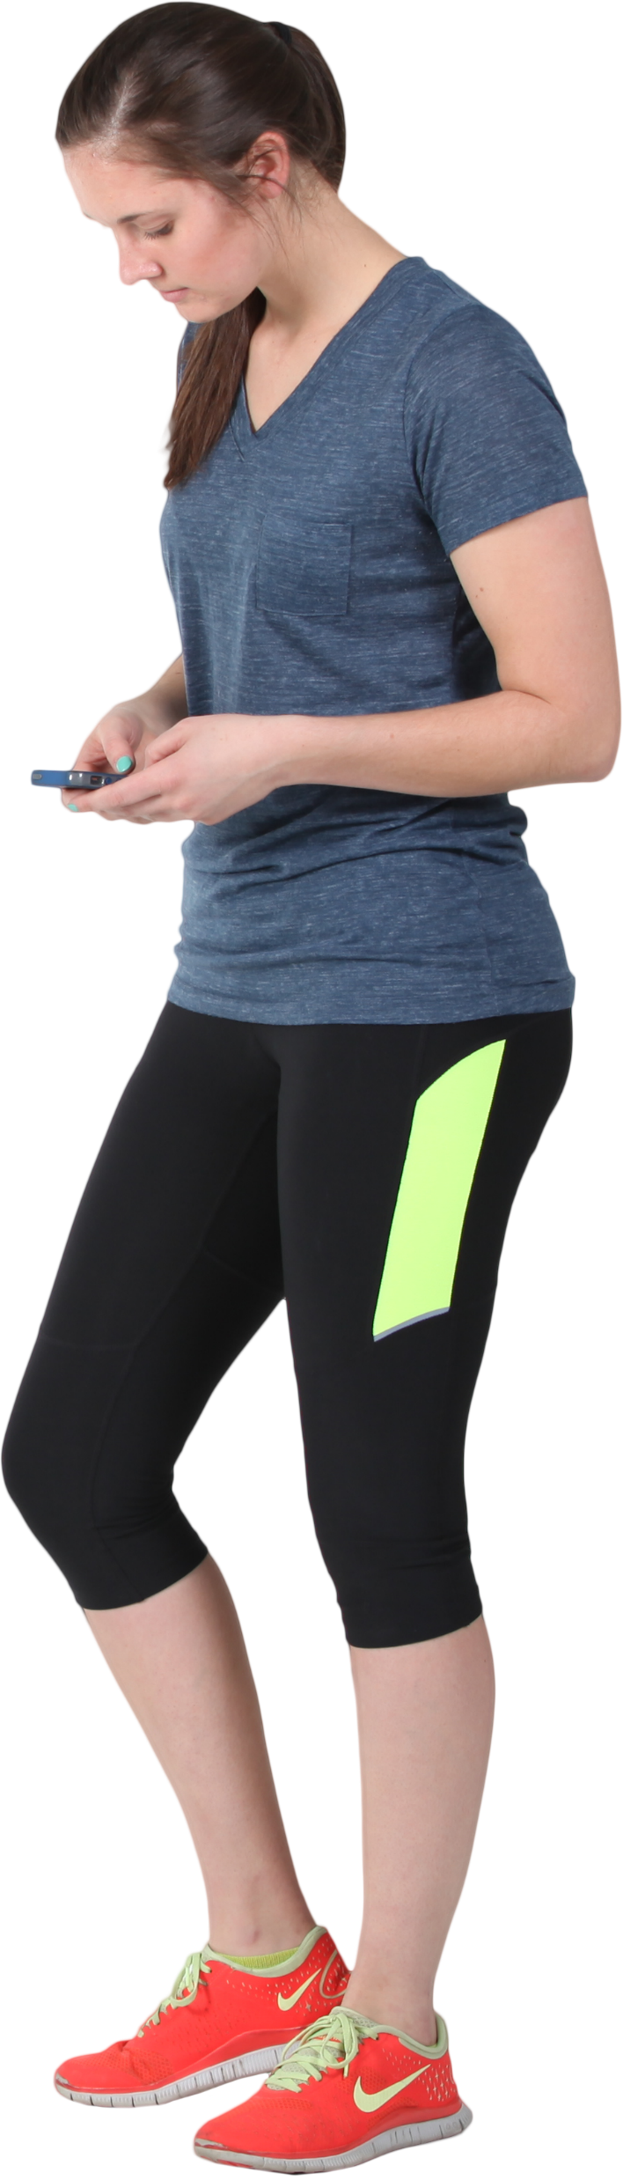
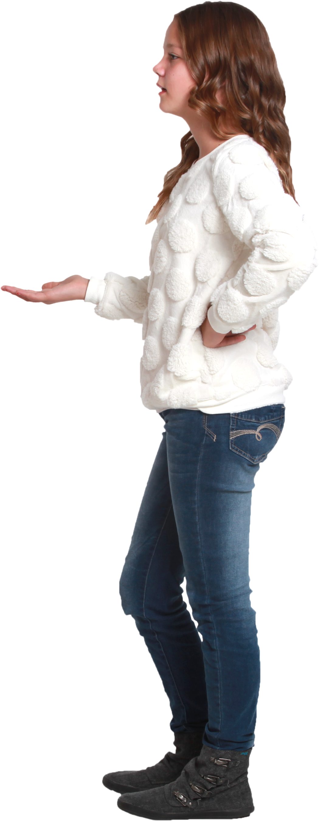

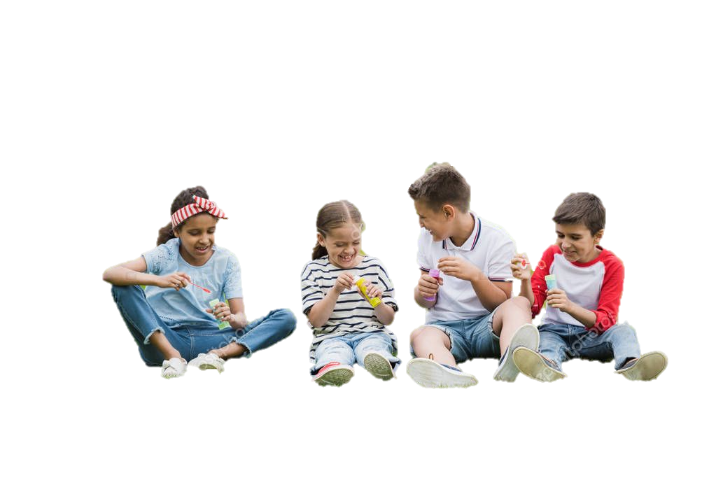
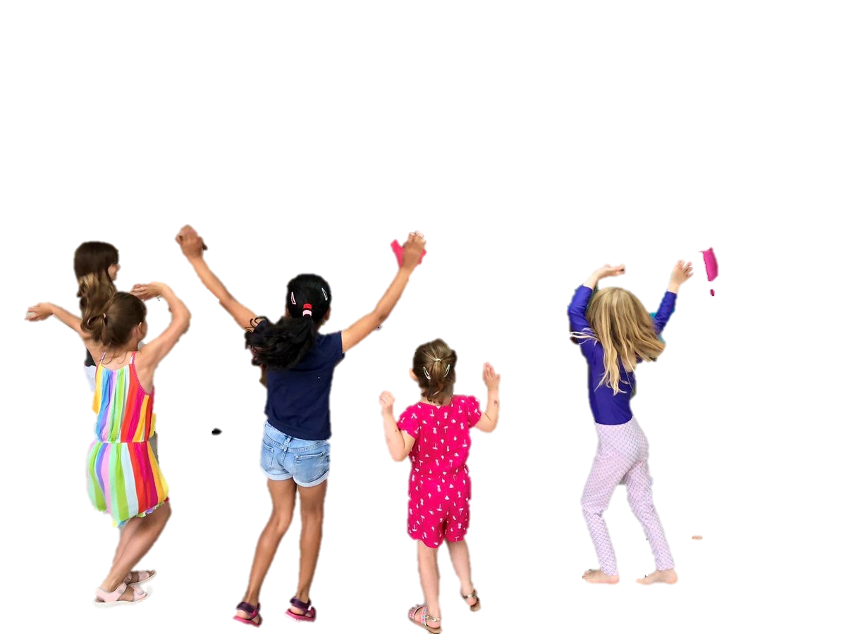
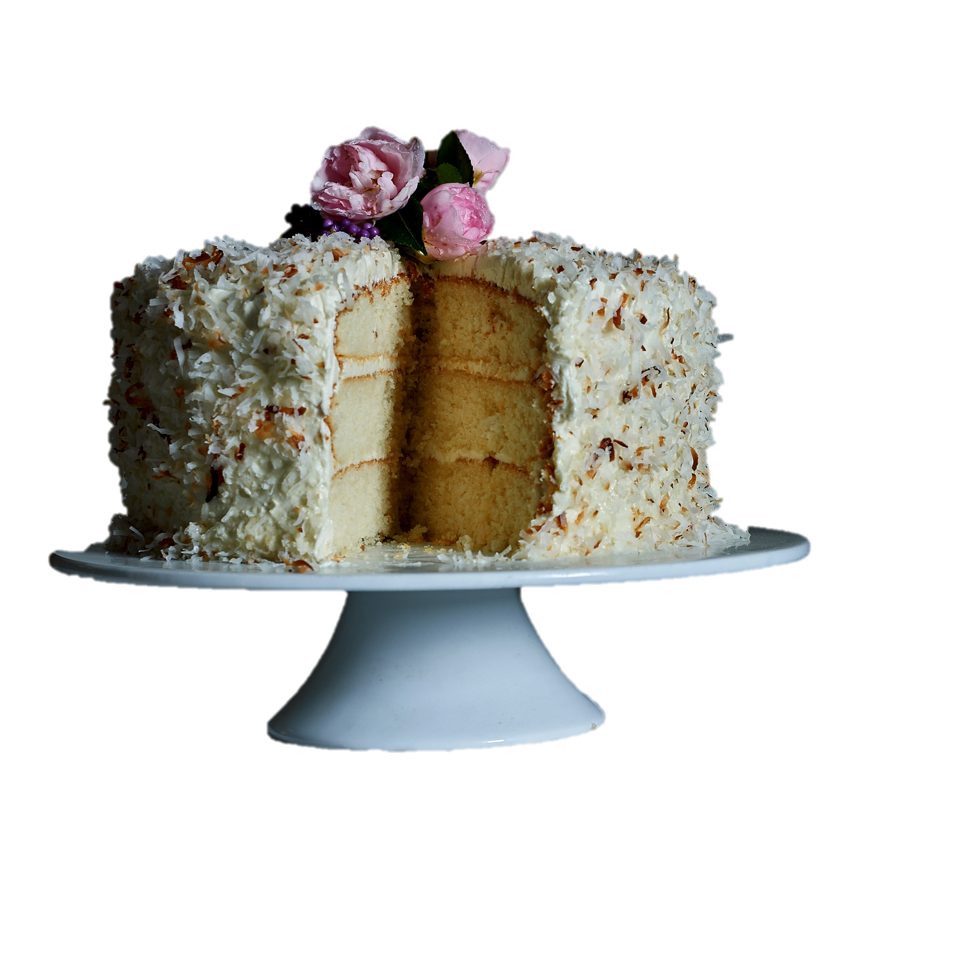
Notes:
And I always have a hard time figuring out how I want to start presentations
but working in noisy places usually helps me concentrate, so when I was agonizing over how I wanted to start this talk, I figured I’d try going park near where I live in Philadelphia to work it out

Slide 4







Notes:
And I always have a hard time figuring out how I want to start presentations
but working in noisy places usually helps me concentrate, so when I was agonizing over how I wanted to start this talk, I figured I’d try going park near where I live in Philadelphia to work it out

Slide 5
Notes:
And I always have a hard time figuring out how I want to start presentations
but working in noisy places usually helps me concentrate, so when I was agonizing over how I wanted to start this talk, I figured I’d try going park near where I live in Philadelphia to work it out

Slide 6

Notes:
And I always have a hard time figuring out how I want to start presentations
but working in noisy places usually helps me concentrate, so when I was agonizing over how I wanted to start this talk, I figured I’d try going park near where I live in Philadelphia to work it out

Slide 7

Notes:
And I always have a hard time figuring out how I want to start presentations
but working in noisy places usually helps me concentrate, so when I was agonizing over how I wanted to start this talk, I figured I’d try going park near where I live in Philadelphia to work it out

Slide 8
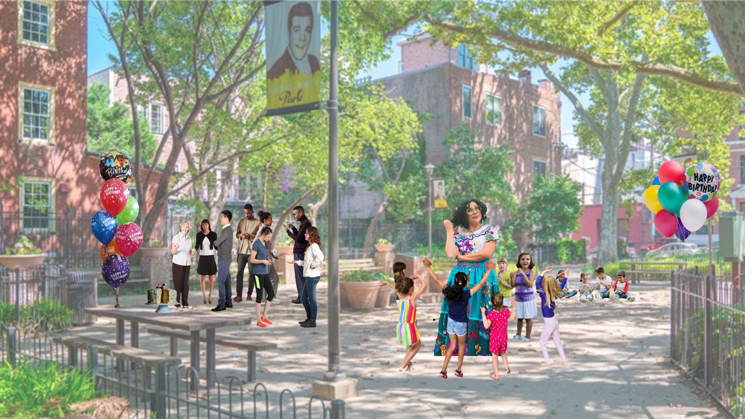
Notes:
And I always have a hard time figuring out how I want to start presentations
but working in noisy places usually helps me concentrate, so when I was agonizing over how I wanted to start this talk, I figured I’d try going park near where I live in Philadelphia to work it out

Slide 9
THE BIG QUESTION
How similarly do children and adults model affective information?
Notes:
And I always have a hard time figuring out how I want to start presentations
but working in noisy places usually helps me concentrate, so when I was agonizing over how I wanted to start this talk, I figured I’d try going park near where I live in Philadelphia to work it out

Slide 10

THE BIG QUESTION
How similarly do children and adults model affective information?
WHY IT MATTERS
Representations influence downstream behaviors and cognitions
Notes:
And I always have a hard time figuring out how I want to start presentations
but working in noisy places usually helps me concentrate, so when I was agonizing over how I wanted to start this talk, I figured I’d try going park near where I live in Philadelphia to work it out

Slide 11


THE BIG QUESTION
How similarly do children and adults model affective information?
WHY IT MATTERS
Representations influence downstream behaviors and cognitions
Understanding normative representations might inform our understanding of non-normative outcomes
Notes:
And I always have a hard time figuring out how I want to start presentations
but working in noisy places usually helps me concentrate, so when I was agonizing over how I wanted to start this talk, I figured I’d try going park near where I live in Philadelphia to work it out

Slide 12
Notes:
And I always have a hard time figuring out how I want to start presentations
but working in noisy places usually helps me concentrate, so when I was agonizing over how I wanted to start this talk, I figured I’d try going park near where I live in Philadelphia to work it out

Slide 13
COMPLEXITY
Notes:
And I always have a hard time figuring out how I want to start presentations
but working in noisy places usually helps me concentrate, so when I was agonizing over how I wanted to start this talk, I figured I’d try going park near where I live in Philadelphia to work it out

Slide 14


DIFFERENTIATION
Notes:
And I always have a hard time figuring out how I want to start presentations
but working in noisy places usually helps me concentrate, so when I was agonizing over how I wanted to start this talk, I figured I’d try going park near where I live in Philadelphia to work it out

Slide 15

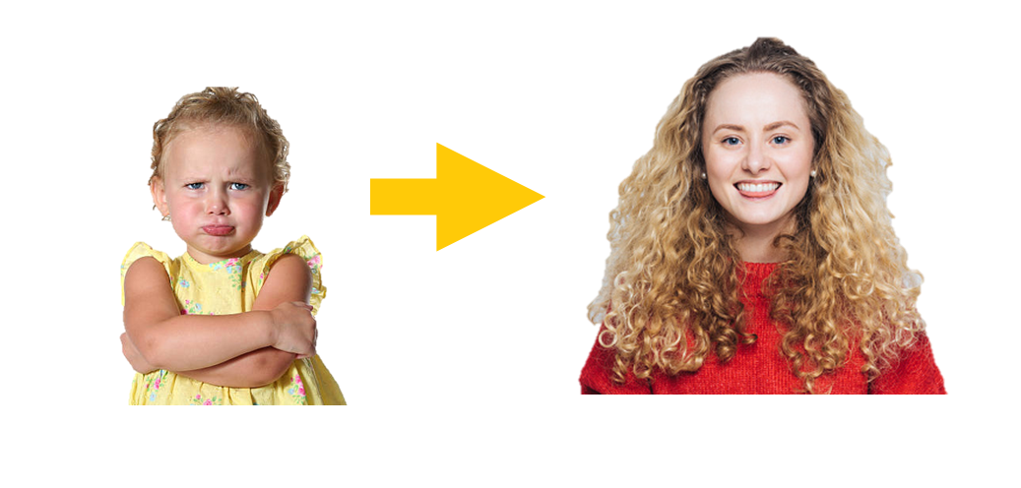

MEANING MAKING
Notes:
And I always have a hard time figuring out how I want to start presentations
but working in noisy places usually helps me concentrate, so when I was agonizing over how I wanted to start this talk, I figured I’d try going park near where I live in Philadelphia to work it out

Slide 16
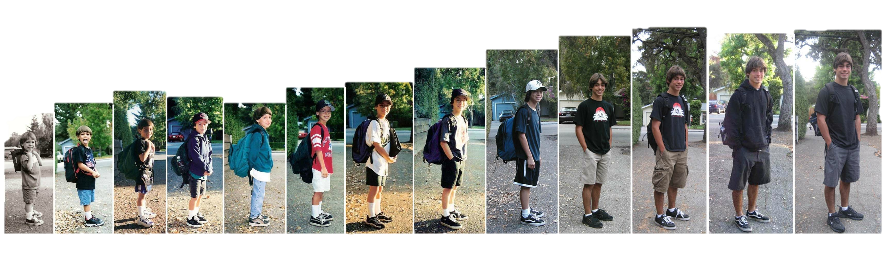
Development is a crucial context for understanding affective cognitions, experiences, and expressions
Notes:
That being that development has a significant impact upon our affective cognitions, experiences, and expressions. This in and of itself isn’t really news. But where and how these differences can be observed is something we as scientists are still appreciating What we know so far

Slide 17






What We Know So Far
We tend to see overt emotion expressions begin around 6-weeks
We tend to see affective labeling begin around 2-years
The ability to read others’ emotions and situations improves throughout early development
Emotional differentiation abilities improve throughout early development

Slide 18
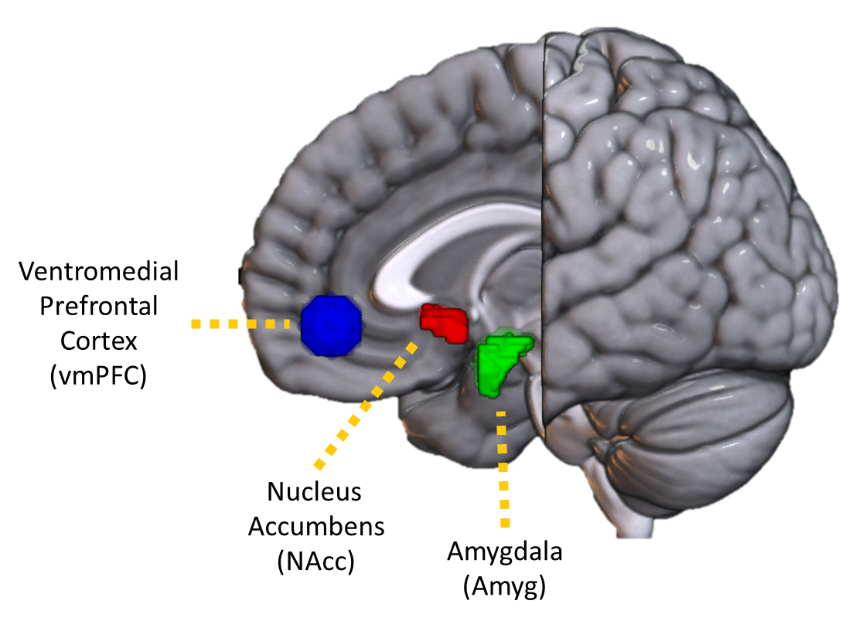
What We Know So Far

Slide 19
What We Know So Far
Adults
Visceral, Automatic Valence Assignment

Slide 20
What We Know So Far
Adults
Synthesis & Assessment of Complex, Multimodal Information
Visceral, Automatic Valence Assignment

Slide 21
What We Know So Far
Adults
Synthesis & Assessment of Complex, Multimodal Information
Visceral, Automatic Valence Assignment

Slide 22
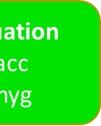
What We Know So Far
Adults
Child
Synthesis
vmPFC
Evaluation
Nacc
Amyg

Slide 23
What We Know So Far
Adults
Child

Slide 24
What We Know So Far
Adults
Child

Slide 25
A MORE SPECIFIC QUESTION
Will children and adults presented with the same affective stimuli show different neural representations of affective information?
Notes:
And I always have a hard time figuring out how I want to start presentations
but working in noisy places usually helps me concentrate, so when I was agonizing over how I wanted to start this talk, I figured I’d try going park near where I live in Philadelphia to work it out

Slide 26
A MORE SPECIFIC QUESTION
Will children and adults presented with the same affective stimuli show different neural representations of affective information?
Notes:
And I always have a hard time figuring out how I want to start presentations
but working in noisy places usually helps me concentrate, so when I was agonizing over how I wanted to start this talk, I figured I’d try going park near where I live in Philadelphia to work it out

Slide 27
A MORE SPECIFIC QUESTION
Will children and adults presented with the same affective stimuli show different neural representations of affective information?

Slide 28

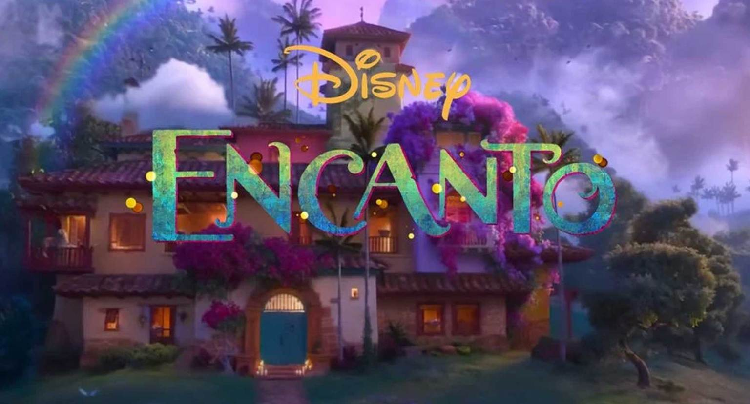
A MORE SPECIFIC QUESTION
Will children and adults presented with the same affective stimuli show different neural representations of affective information?
Notes:
And I always have a hard time figuring out how I want to start presentations
but working in noisy places usually helps me concentrate, so when I was agonizing over how I wanted to start this talk, I figured I’d try going park near where I live in Philadelphia to work it out

Slide 29
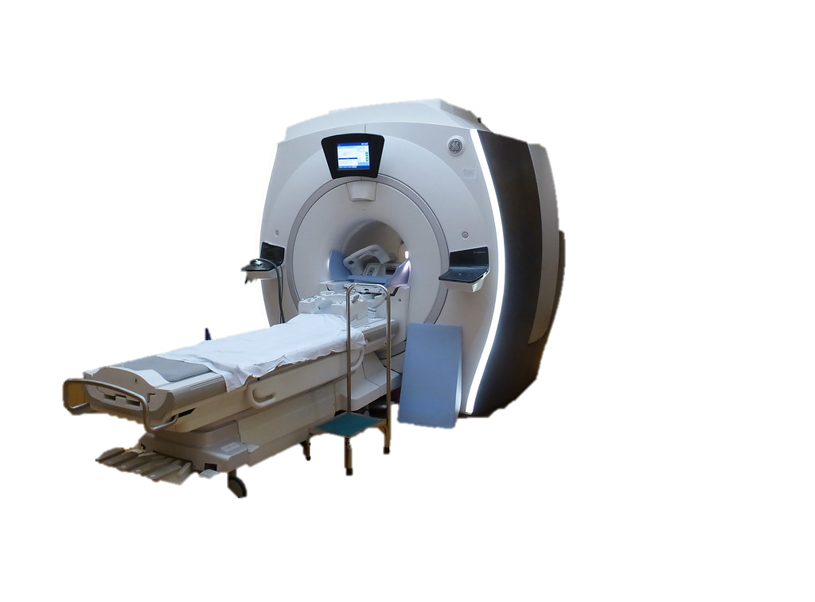
A MORE SPECIFIC QUESTION
Will children and adults presented with the same affective stimuli show different neural representations of affective information?
Notes:
And I always have a hard time figuring out how I want to start presentations
but working in noisy places usually helps me concentrate, so when I was agonizing over how I wanted to start this talk, I figured I’d try going park near where I live in Philadelphia to work it out

Slide 30

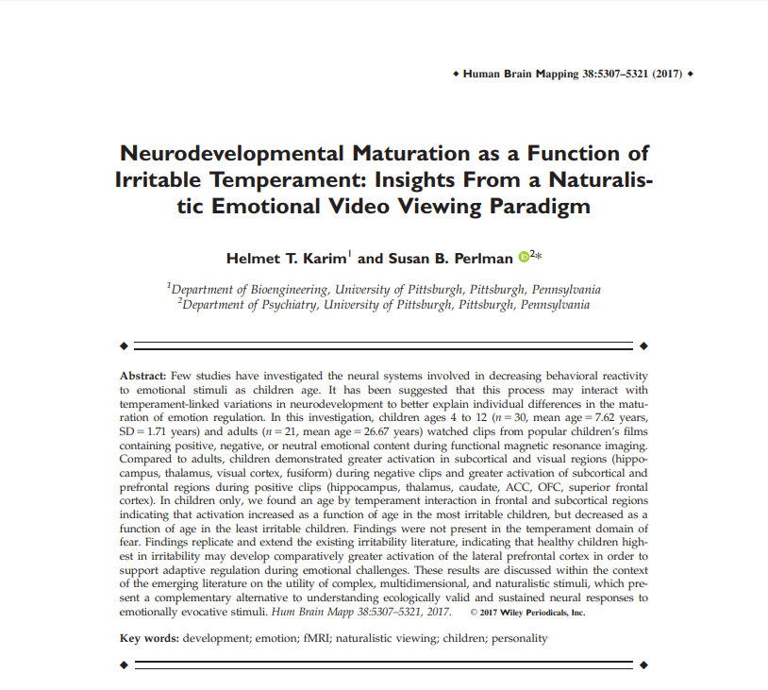



21 Adults
1 excluded for head motion ages 20 - 44 (M =26.7 yrs, sd = 5.20 yrs)
36 Children
11 excluded for head motion ages 4-10 (M =7.4 yrs, sd = 1.85 yrs)

Slide 31

Stimuli
24 Film Clips (~ 17 mins):
Notes:
It consisted of 24 clips from popular movies
that were evenly divided into positive, negative, and neutral valence categories.
(PAUSE)
Clips contained both animated and live action movies,
anthropomorphic and human characters
and spanned a long time period, with release dates from 1939 to 2011.
In total, participants were exposed to about 20 minutes of continuous stimuli
(PAUSE)
So, again, we have a high volume of stimuli with a lot of variability surrounding a few core common traits.

Slide 32



Stimuli
24 Film Clips (~ 17 mins):
8 positive
Popular Movies
8 negative
8 neutral
Nature Documentaries
Notes:
It consisted of 24 clips from popular movies
that were evenly divided into positive, negative, and neutral valence categories.
(PAUSE)
Clips contained both animated and live action movies,
anthropomorphic and human characters
and spanned a long time period, with release dates from 1939 to 2011.
In total, participants were exposed to about 20 minutes of continuous stimuli
(PAUSE)
So, again, we have a high volume of stimuli with a lot of variability surrounding a few core common traits.

Slide 33


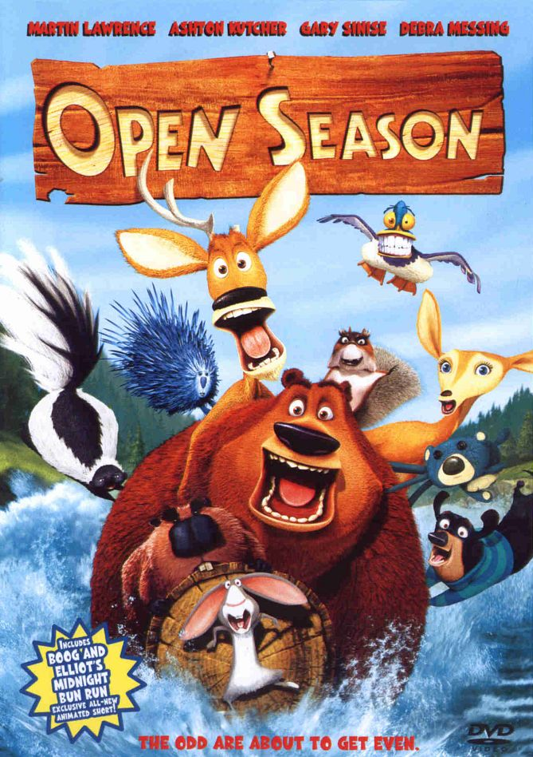

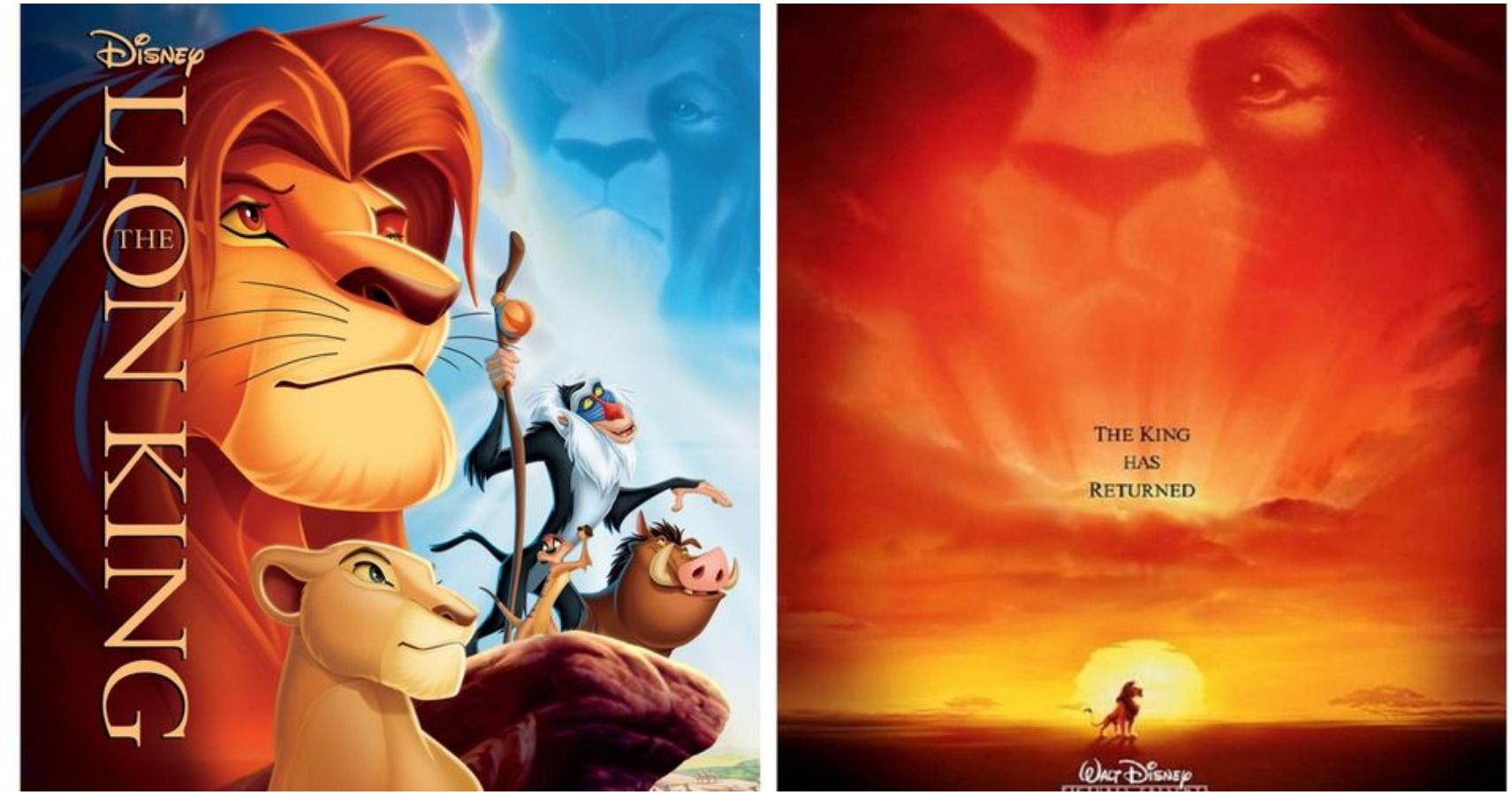
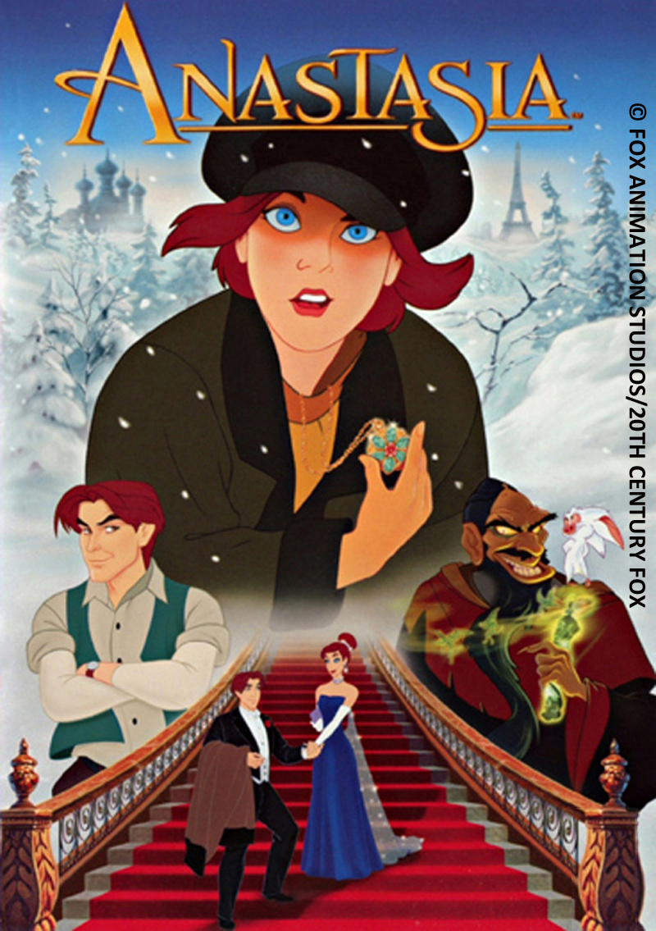


Stimuli
Song
Spoken Word
24 Film Clips (~ 17 mins):
Animated
Live Action
8 positive
Popular Movies
8 negative
8 neutral
Nature Documentaries
Anthropomorphic
Human
1939
-
2011
Notes:
It consisted of 24 clips from popular movies
that were evenly divided into positive, negative, and neutral valence categories.
(PAUSE)
Clips contained both animated and live action movies,
anthropomorphic and human characters
and spanned a long time period, with release dates from 1939 to 2011.
In total, participants were exposed to about 20 minutes of continuous stimuli
(PAUSE)
So, again, we have a high volume of stimuli with a lot of variability surrounding a few core common traits.

Slide 34
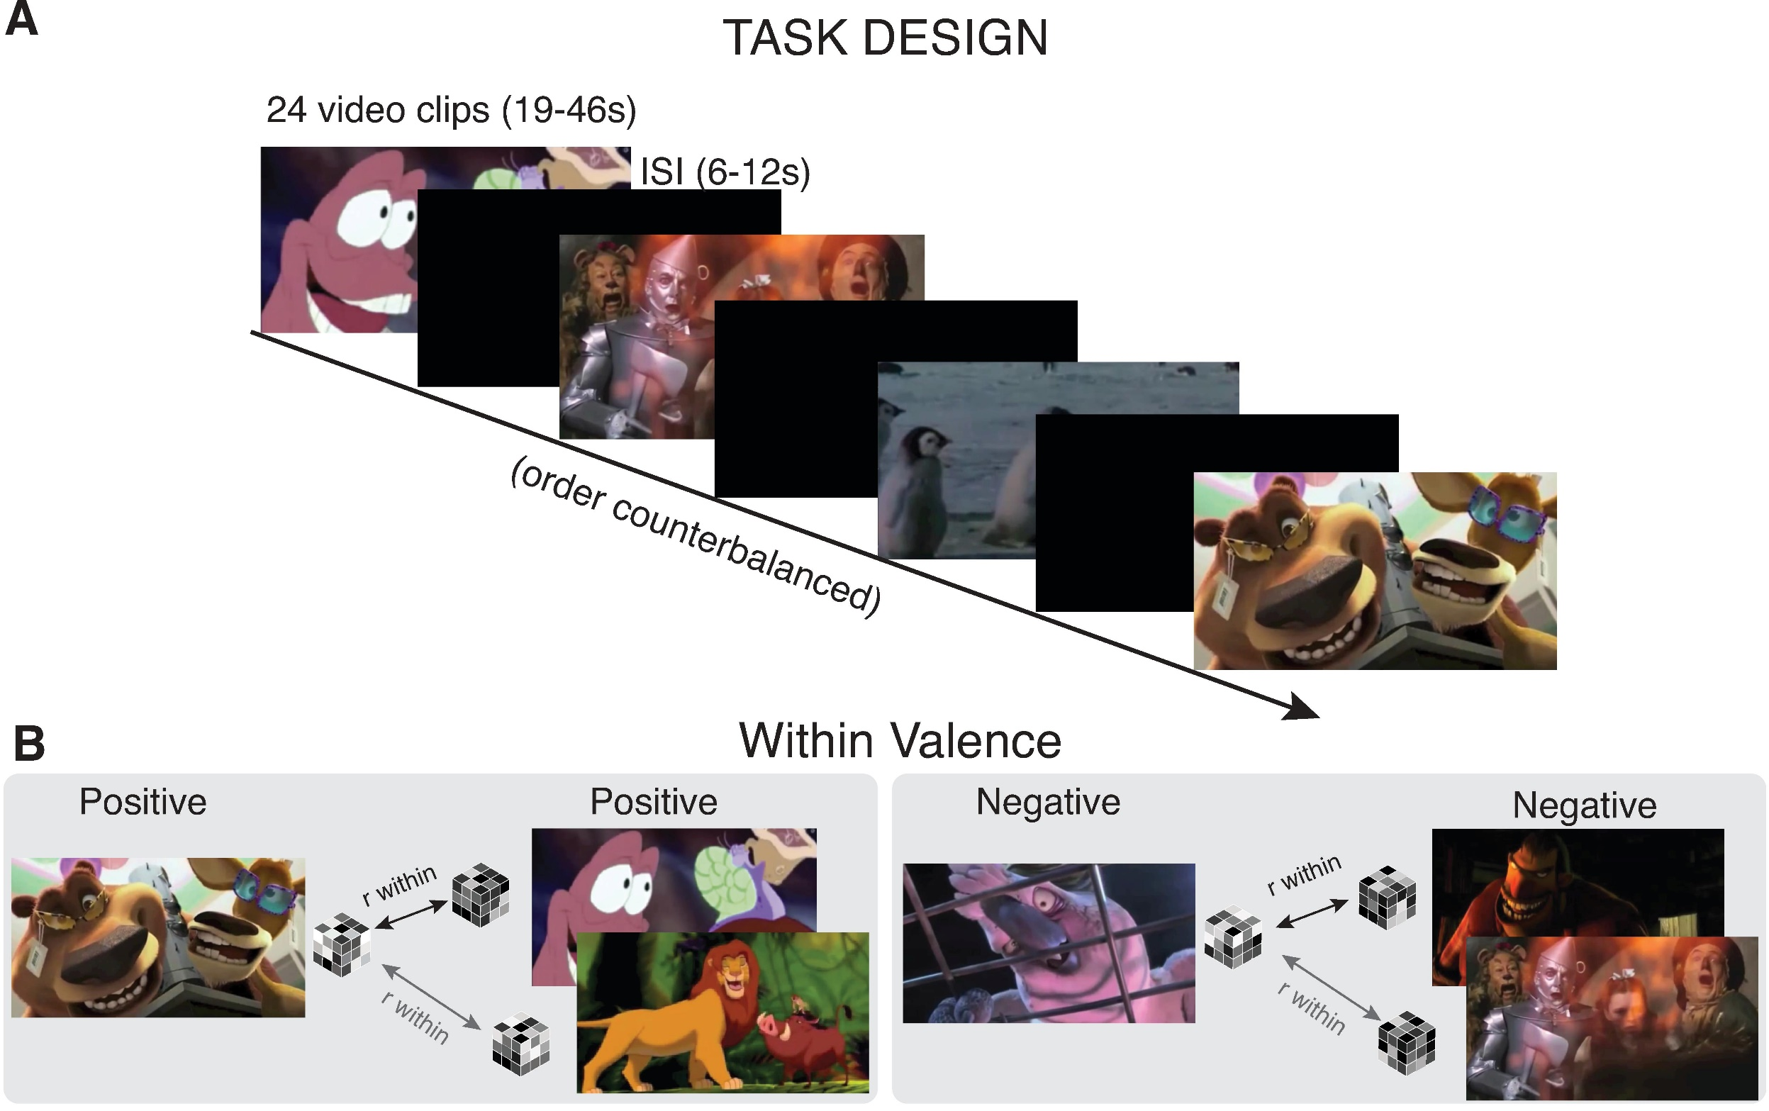
Stimuli
Song
Spoken Word
24 Film Clips (~ 17 mins):
Animated
Live Action
8 positive
Popular Movies
8 negative
8 neutral
Nature Documentaries
Anthropomorphic
Human
1939
-
2011
Notes:
It consisted of 24 clips from popular movies
that were evenly divided into positive, negative, and neutral valence categories.
(PAUSE)
Clips contained both animated and live action movies,
anthropomorphic and human characters
and spanned a long time period, with release dates from 1939 to 2011.
In total, participants were exposed to about 20 minutes of continuous stimuli
(PAUSE)
So, again, we have a high volume of stimuli with a lot of variability surrounding a few core common traits.

Slide 35
Stimuli
24 Film Clips (~ 17 mins):
Notes:
It consisted of 24 clips from popular movies
that were evenly divided into positive, negative, and neutral valence categories.
(PAUSE)
Clips contained both animated and live action movies,
anthropomorphic and human characters
and spanned a long time period, with release dates from 1939 to 2011.
In total, participants were exposed to about 20 minutes of continuous stimuli
(PAUSE)
So, again, we have a high volume of stimuli with a lot of variability surrounding a few core common traits.

Slide 36
Stimuli
24 Film Clips (~ 17 mins):
8 positive
Popular Movies
8 negative
8 neutral
Nature Documentaries
Notes:
It consisted of 24 clips from popular movies
that were evenly divided into positive, negative, and neutral valence categories.
(PAUSE)
Clips contained both animated and live action movies,
anthropomorphic and human characters
and spanned a long time period, with release dates from 1939 to 2011.
In total, participants were exposed to about 20 minutes of continuous stimuli
(PAUSE)
So, again, we have a high volume of stimuli with a lot of variability surrounding a few core common traits.

Slide 37
Stimuli
Song
Spoken Word
24 Film Clips (~ 17 mins):
8 positive
Animated
Live Action
Popular Movies
8 negative
8 neutral
Nature Documentaries
Anthropomorphic
Human
1939
-
2011
Notes:
It consisted of 24 clips from popular movies
that were evenly divided into positive, negative, and neutral valence categories.
(PAUSE)
Clips contained both animated and live action movies,
anthropomorphic and human characters
and spanned a long time period, with release dates from 1939 to 2011.
In total, participants were exposed to about 20 minutes of continuous stimuli
(PAUSE)
So, again, we have a high volume of stimuli with a lot of variability surrounding a few core common traits.

Slide 38
Stimuli
Song
Spoken Word
24 Film Clips (~ 17 mins):
8 positive
Animated
Live Action
Popular Movies
8 negative
8 neutral
Nature Documentaries
Anthropomorphic
Human
1939
-
2011
Notes:
It consisted of 24 clips from popular movies
that were evenly divided into positive, negative, and neutral valence categories.
(PAUSE)
Clips contained both animated and live action movies,
anthropomorphic and human characters
and spanned a long time period, with release dates from 1939 to 2011.
In total, participants were exposed to about 20 minutes of continuous stimuli
(PAUSE)
So, again, we have a high volume of stimuli with a lot of variability surrounding a few core common traits.

Slide 39





Stimuli
Song
Spoken Word
24 Film Clips (~ 17 mins):
Affective clips were balanced by:
8 positive
Animated
Live Action
Luminance
Popular Movies
8 negative
Screen Time
8 neutral
Nature Documentaries
Presence of Faces
Human
Affective Intensity
Anthropomorphic
1939
-
2011
Notes:
It consisted of 24 clips from popular movies
that were evenly divided into positive, negative, and neutral valence categories.
(PAUSE)
Clips contained both animated and live action movies,
anthropomorphic and human characters
and spanned a long time period, with release dates from 1939 to 2011.
In total, participants were exposed to about 20 minutes of continuous stimuli
(PAUSE)
So, again, we have a high volume of stimuli with a lot of variability surrounding a few core common traits.

Slide 40




Stimuli
Song
Spoken Word
24 Film Clips (~ 17 mins):
Affective clips were balanced by:
8 positive
Animated
Live Action
Luminance
Popular Movies
8 negative
Screen Time
8 neutral
Nature Documentaries
Presence of Faces
Human
Affective Intensity
Anthropomorphic
No age differences in:
1939
-
2011
Familiarity
Engagement
Notes:
It consisted of 24 clips from popular movies
that were evenly divided into positive, negative, and neutral valence categories.
(PAUSE)
Clips contained both animated and live action movies,
anthropomorphic and human characters
and spanned a long time period, with release dates from 1939 to 2011.
In total, participants were exposed to about 20 minutes of continuous stimuli
(PAUSE)
So, again, we have a high volume of stimuli with a lot of variability surrounding a few core common traits.

Slide 41
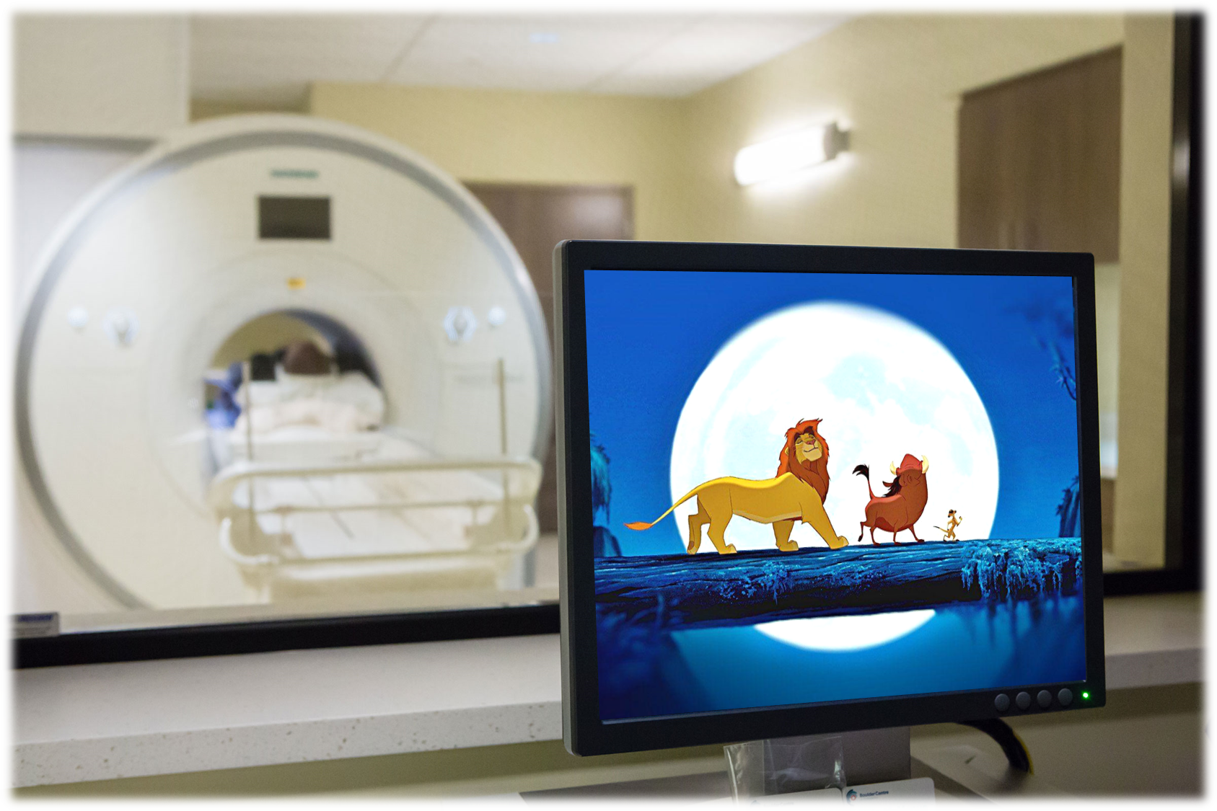
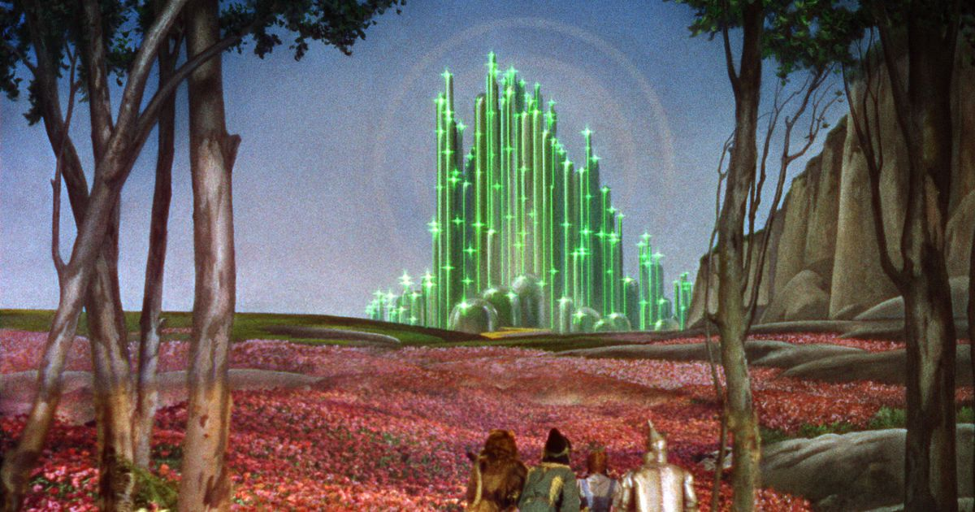

Slide 42
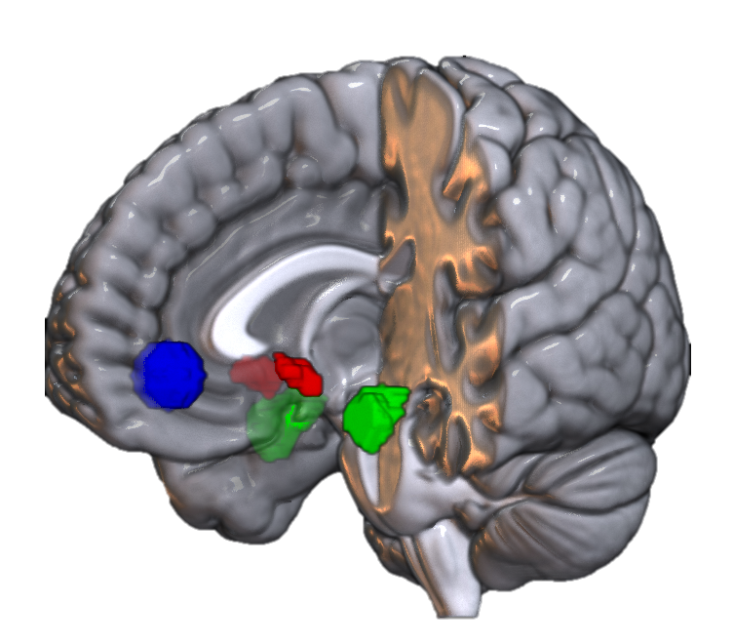

Slide 43

Less Activation Relative to Baseline
Greater Activation Relative to Baseline

Slide 44
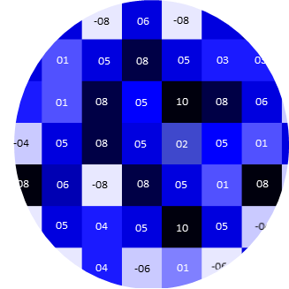
Less Activation Relative to Baseline
Greater Activation Relative to Baseline

Slide 45
Less Activation Relative to Baseline
Greater Activation Relative to Baseline

Slide 46
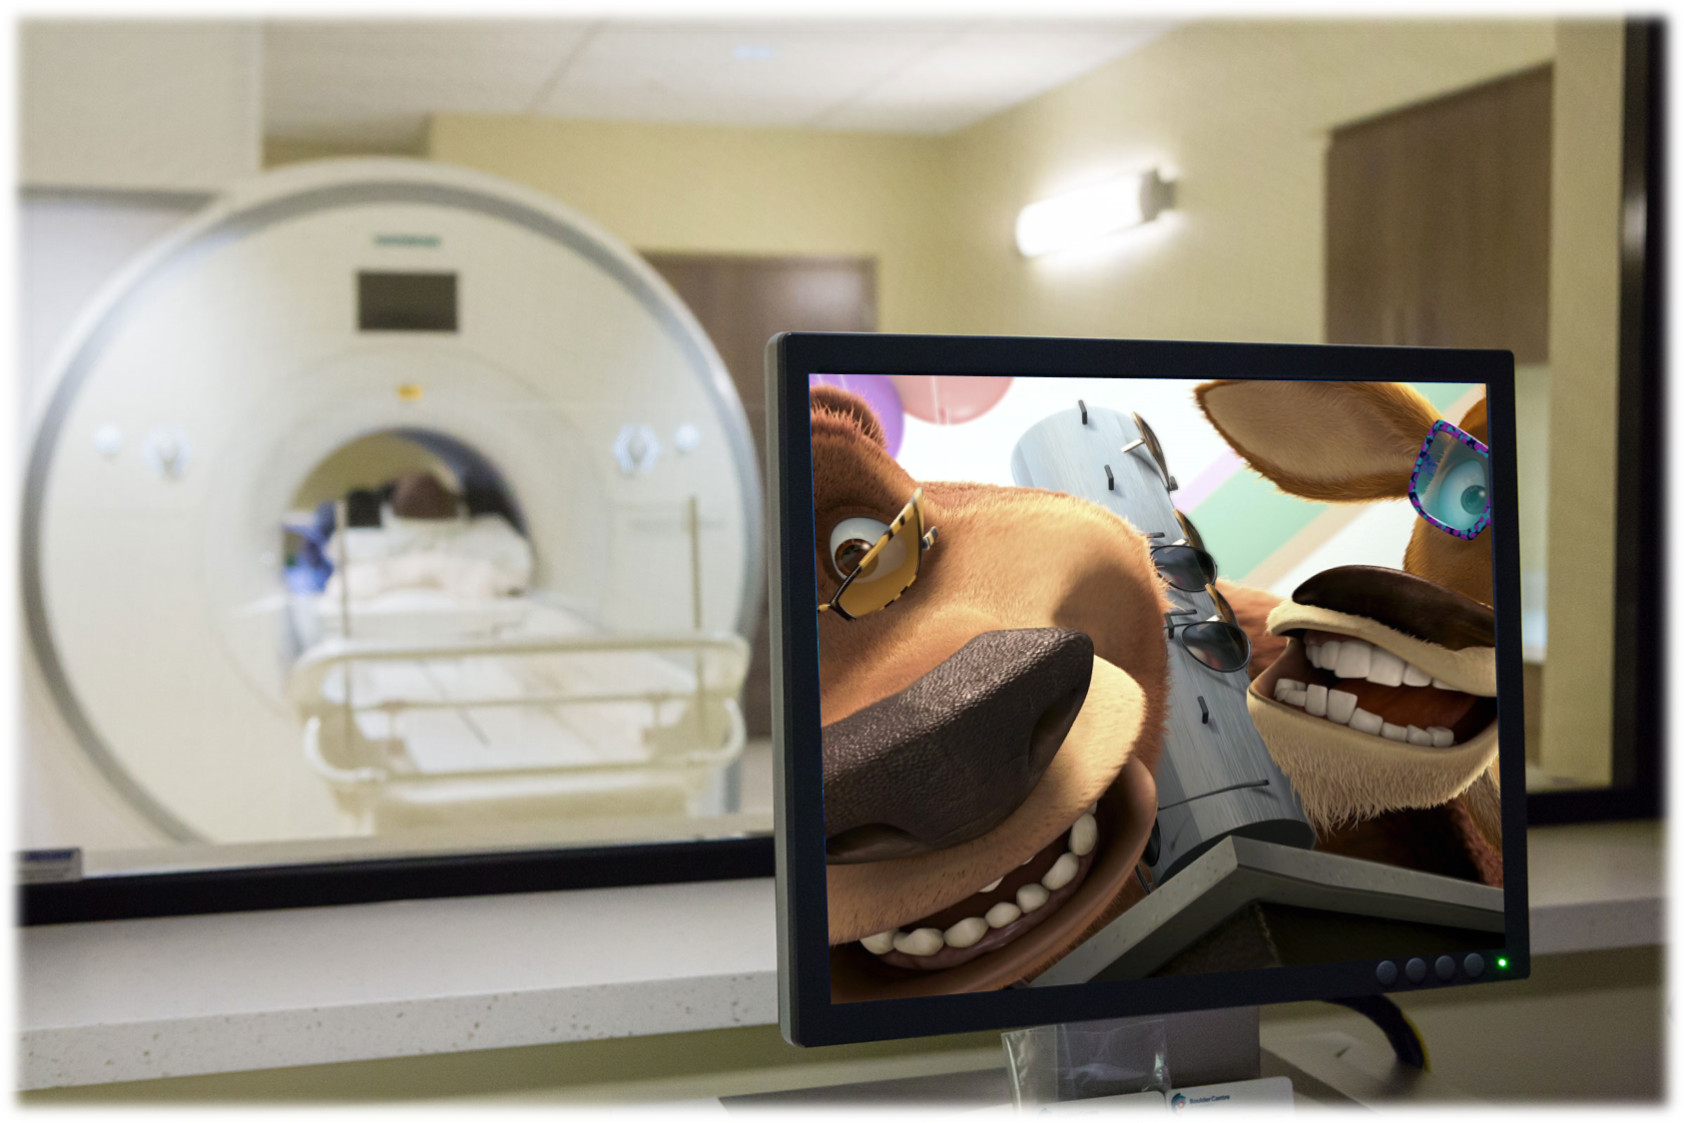
Less Activation Relative to Baseline
Greater Activation Relative to Baseline

Slide 47
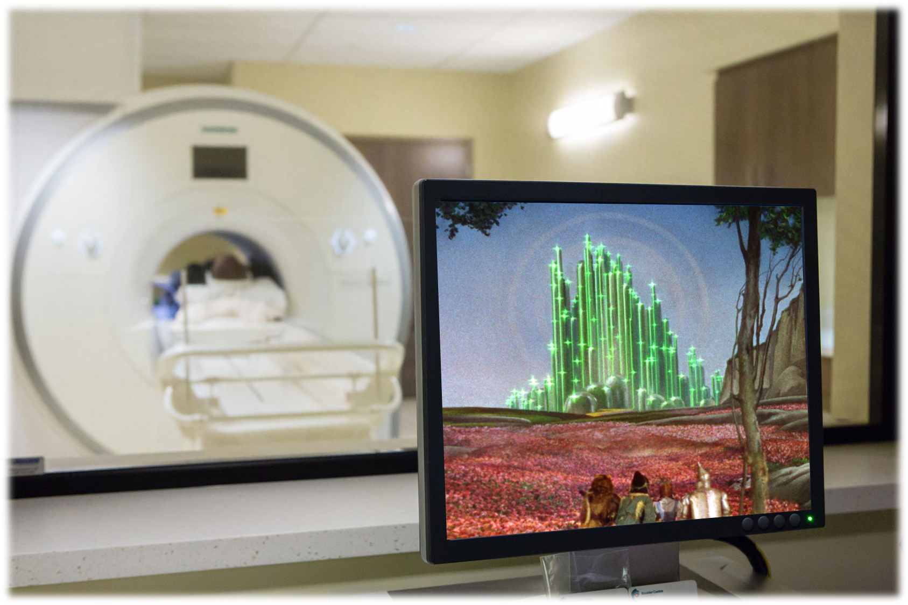
Less Activation Relative to Baseline
Greater Activation Relative to Baseline

Slide 48
#
#
#
#
#
#
#
#
#
#
#
#
#
#
#
#
#
#
#
#
#
#
#
#
#
#
#
#
#
#
#
#
#
#
#
#
#
#
#
#
#
#
#
#
#
#
#
#
#
#
#
#
#
#
#
#
#
#
#
#
#
#
#
#
#
#
#
#
#
#
#
#
#
#
#
#
#
Less Activation Relative to Baseline
Greater Activation Relative to Baseline

Slide 49
#
#
#
#
#
#
#
#
#
#
#
#
#
#
#
#
#
#
#
#
#
#
#
#
#
#
#
#
#
#
#
#
#
#
#
#
#
#
#
#
#
#
#
#
#
#
#
#
#
#
#
#
#
#
#
#
#
#
#
#
#
#
#
#
#
#
#
#
#
#
#
#
#
#
#
#
#

Slide 50
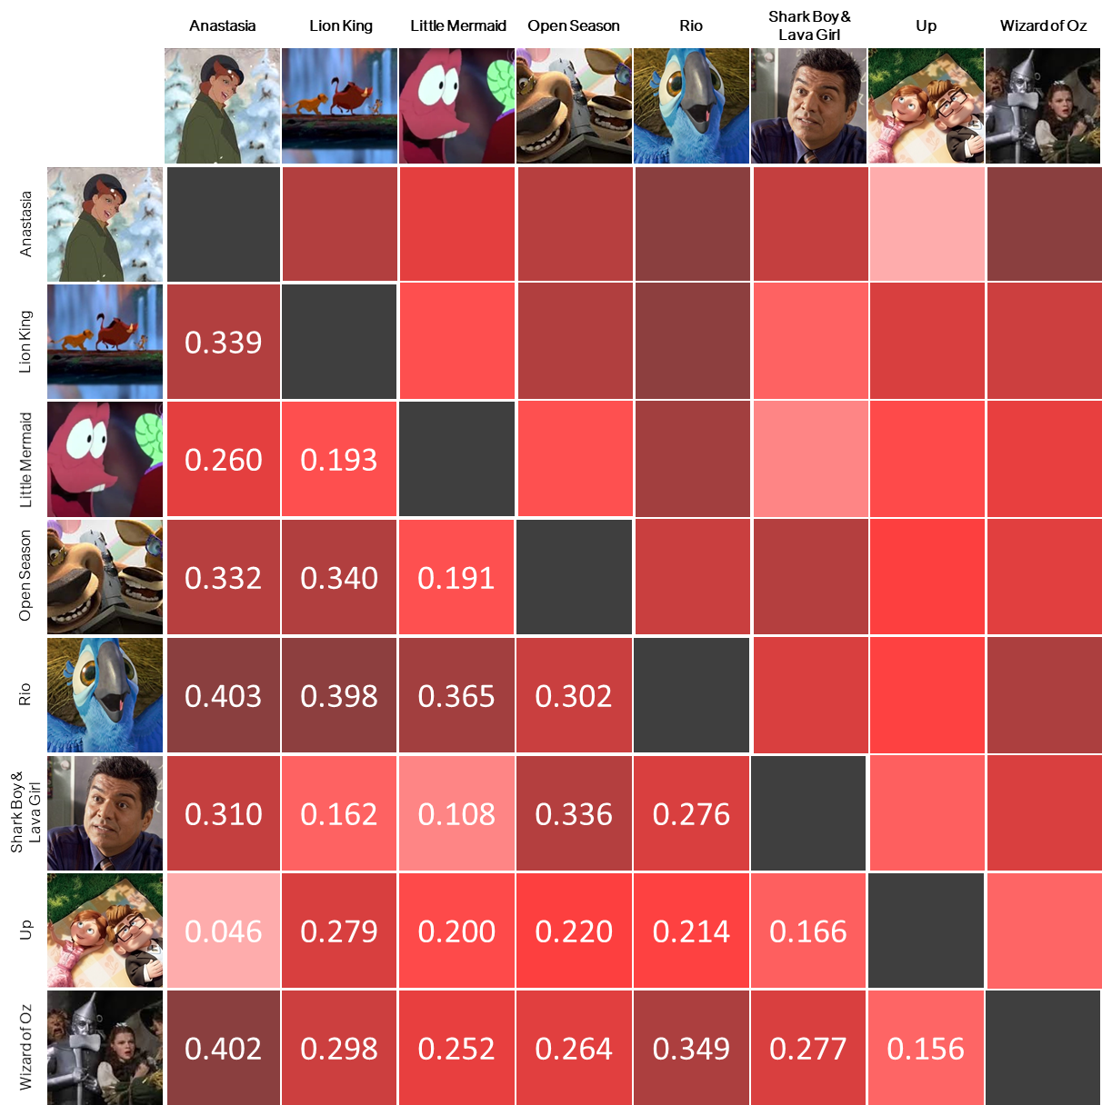
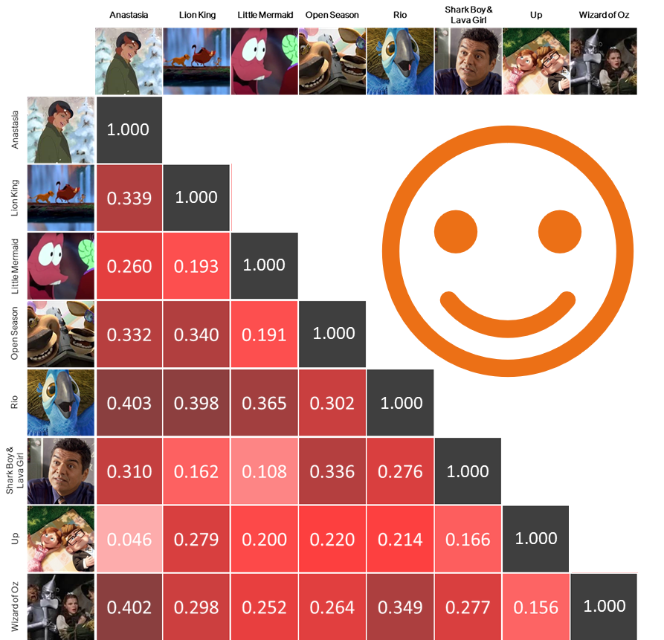
1.000
1.000
1.000
1.000
1.000
1.000
1.000
1.000

Slide 51
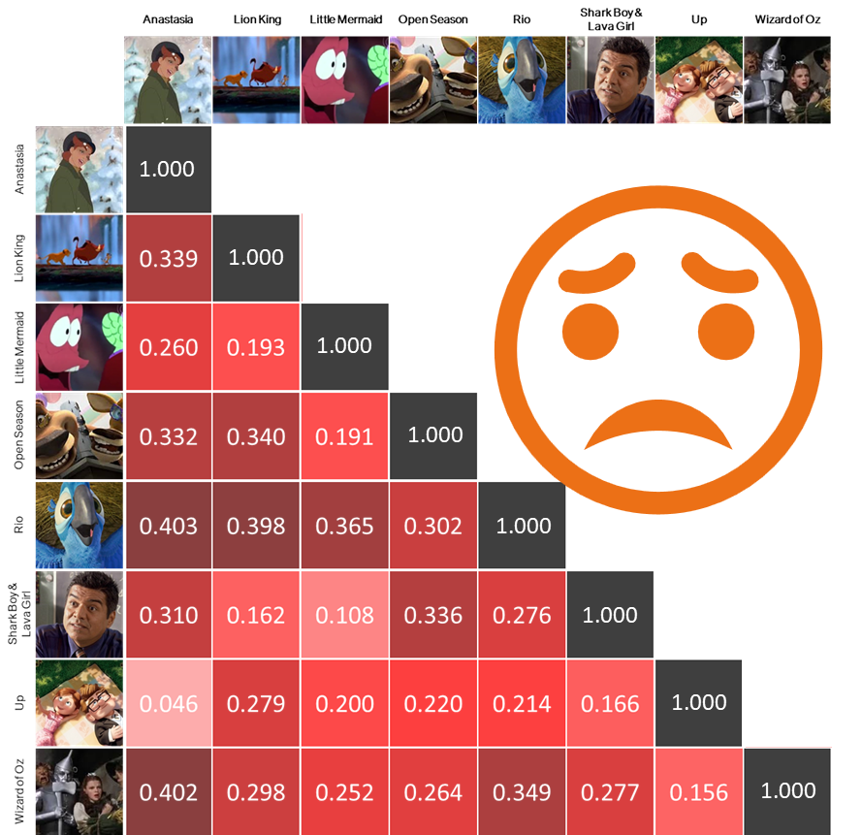
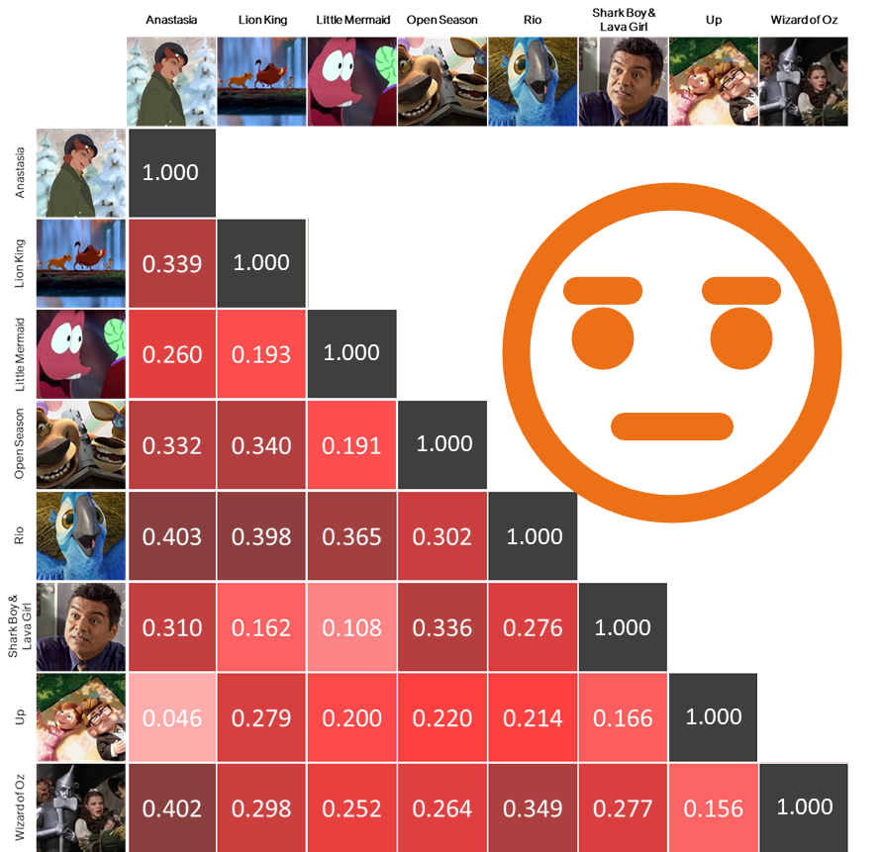

Slide 52
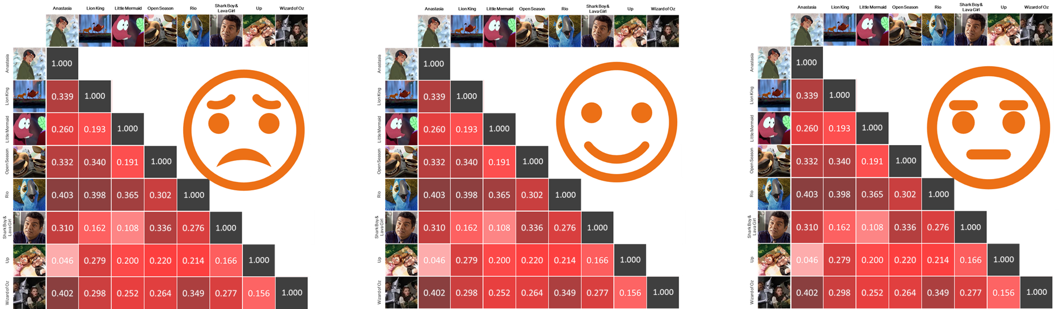

Slide 53
We can then compare group averages in representational similarity using mixed effects models

Slide 54
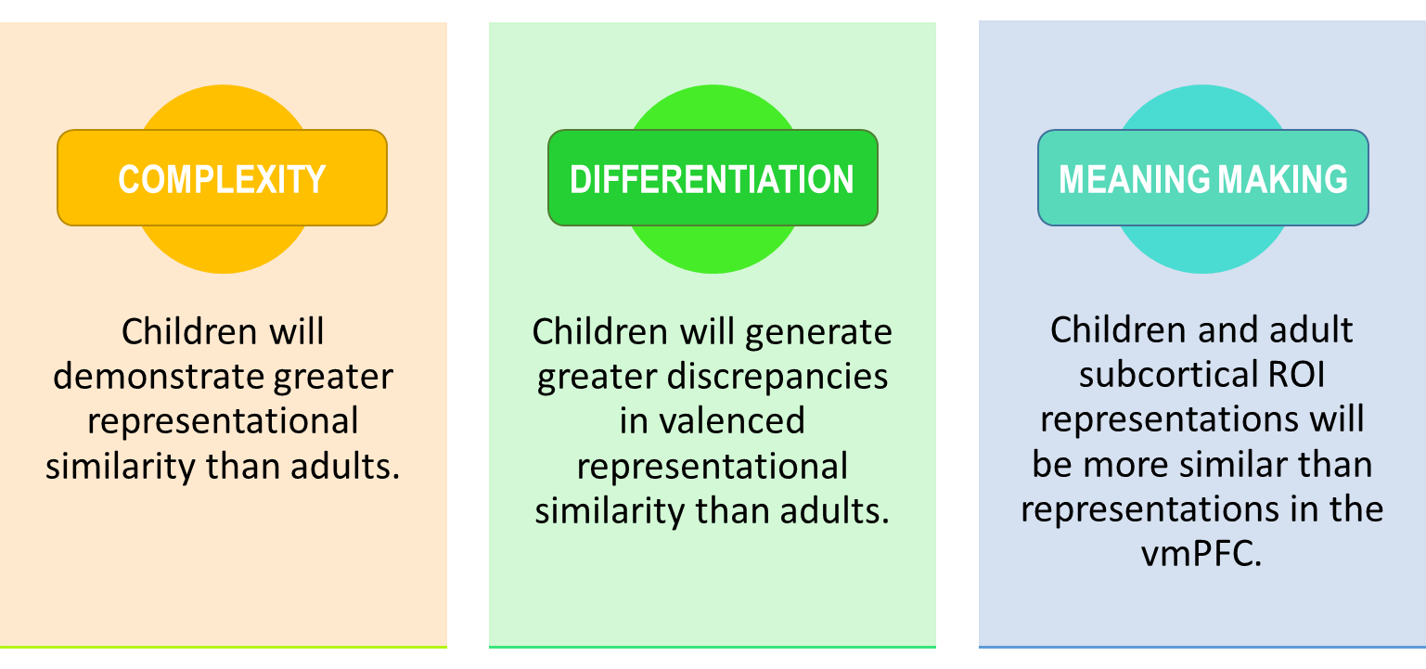
Hypotheses
Notes:
Lastly, because of the profound functional and connective prefrontal developments,
relative to subcortical developments,
we expected to see an interaction
Such that the difference in pattern similarity between child prefrontal and subcortical regions
should be greater than the difference between adult prefrontal and subcortical regions.
(PAUSE)
And of course, we take this to be a sign that adults are demonstrating greater ability in that post-representation assessment stage.

Slide 55
Hypotheses
Notes:
And we wanted to test a few hypotheses with this setup First is what I would consider general complexity. Because from the behavioral research, we know that expressions of affect grow more nuanced as children age, we should expect to see that neural representations among children are generally more similar to one another than are adults

Slide 56

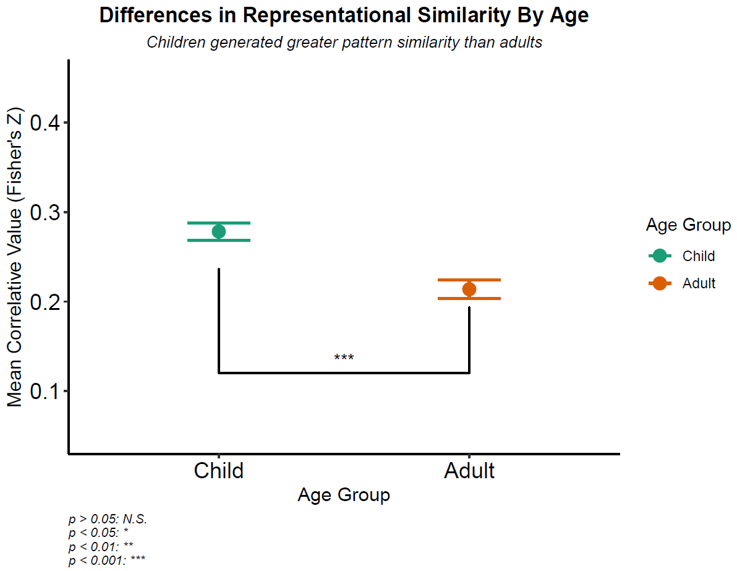
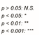
Supported
More Similar
Overall, children did demonstrate greater pattern similarity relative to adults.
Less Similar
Notes:
{TALK ABOUT AXES}

Slide 57
Supported
More Similar
Overall, children did demonstrate greater pattern similarity relative to adults.
Less Similar

Slide 58
Hypotheses
Notes:
Building upon our first hypothesis we wanted to explore intra-valence differentiation across ages Researchers have theorized that children generate representations of affect that fall pretty strongly along valence lines,
while the complexity of affective representations in adulthood
Might render valence to be an insufficient framework to apply to adult representations.

Slide 59

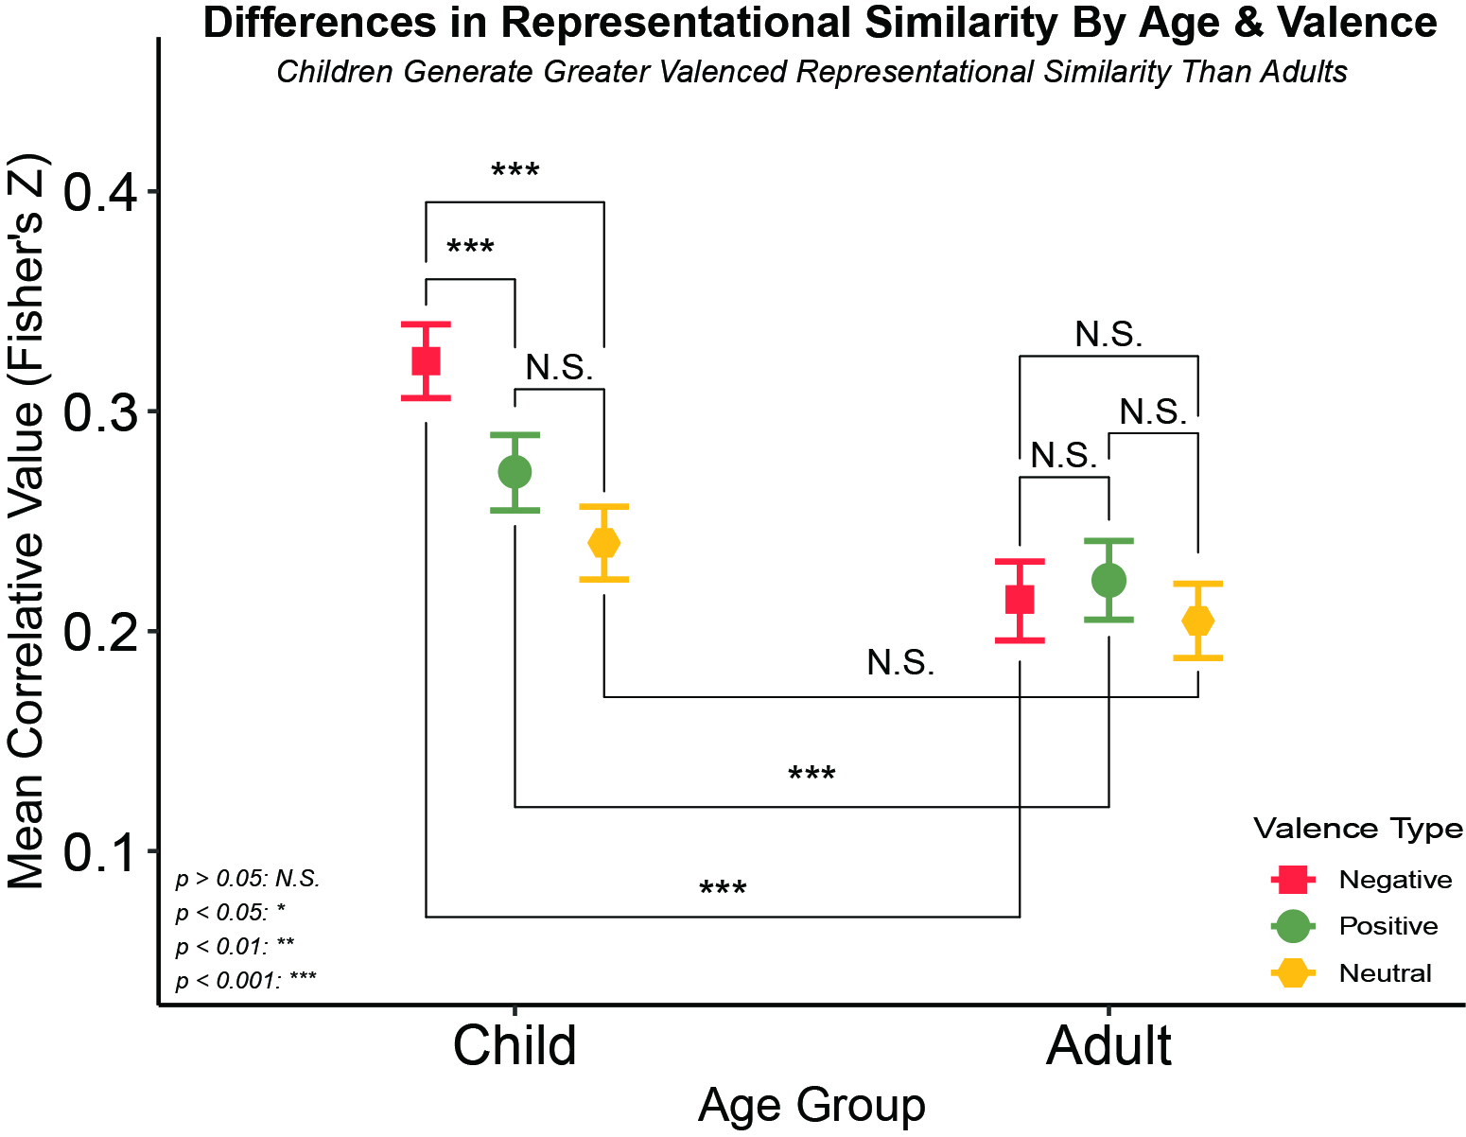
Supported
More Similar
Children Generate Greater Valenced Representational Similarity Than Adults
Children also demonstrated greater affective pattern similarity relative to our neutral control, while adults did not seem to differentiate along affective lines.
Less Similar
Notes:
Going back to the interaction between valence and age in our mixed effects models, we actually found support for this notion. On the X axis, we have our age groups,
on the y axis we have our correlative values, and orange, green, and yellow for negative, positive and neutral valences respectively
so higher values mean that the patterns we observed were more similar to each other,
and lower values mean that they were less similar to each other within that specific Age / Valence group.
And lastly, we have valence as our moderator with relevant key over to the right.

Slide 60
Supported
More Similar
Children Generate Greater Valenced Representational Similarity Than Adults
Children also demonstrated greater affective pattern similarity relative to our neutral control, while adults did not seem to differentiate along affective lines.
Less Similar
Notes:
First, we see no differences among adults by valence
This is in line with what we suspect, that valence might not be as appropriate of a heuristic or model for adults, being too general

Slide 61
Supported
More Similar
Children Generate Greater Valenced Representational Similarity Than Adults
Children also demonstrated greater affective pattern similarity relative to our neutral control, while adults did not seem to differentiate along affective lines.
Less Similar
Notes:
For children, we do see differences between negative and positive and positive and neutral,
But interestingly enough not positive and neutral
This difference could be a product of the prominence a lot of negatively valenced events demonstrate
Especially in moral domains for children.

Slide 62
Supported
More Similar
Children Generate Greater Valenced Representational Similarity Than Adults
Children also demonstrated greater affective pattern similarity relative to our neutral control, while adults did not seem to differentiate along affective lines.
Less Similar
Notes:
But, most important,
We see that both positive and negative, but not netural valenced stimuli,
Generated greater pattern similarity in children relative to adults,
Again which suggests that children are representing negative things pretty similarity to other negative things
And positive things pretty similarity to other positive things,
And not differentiating as much nuance as their adult counterparts seem to be doing

Slide 63
Hypotheses
Notes:
Lastly, because of the profound functional and connective prefrontal developments,
relative to subcortical developments,
we expected to see an interaction
Such that the difference in pattern similarity between child prefrontal and subcortical regions
should be greater than the difference between adult prefrontal and subcortical regions.
(PAUSE)
And of course, we take this to be a sign that adults are demonstrating greater ability in that post-representation assessment stage.

Slide 64

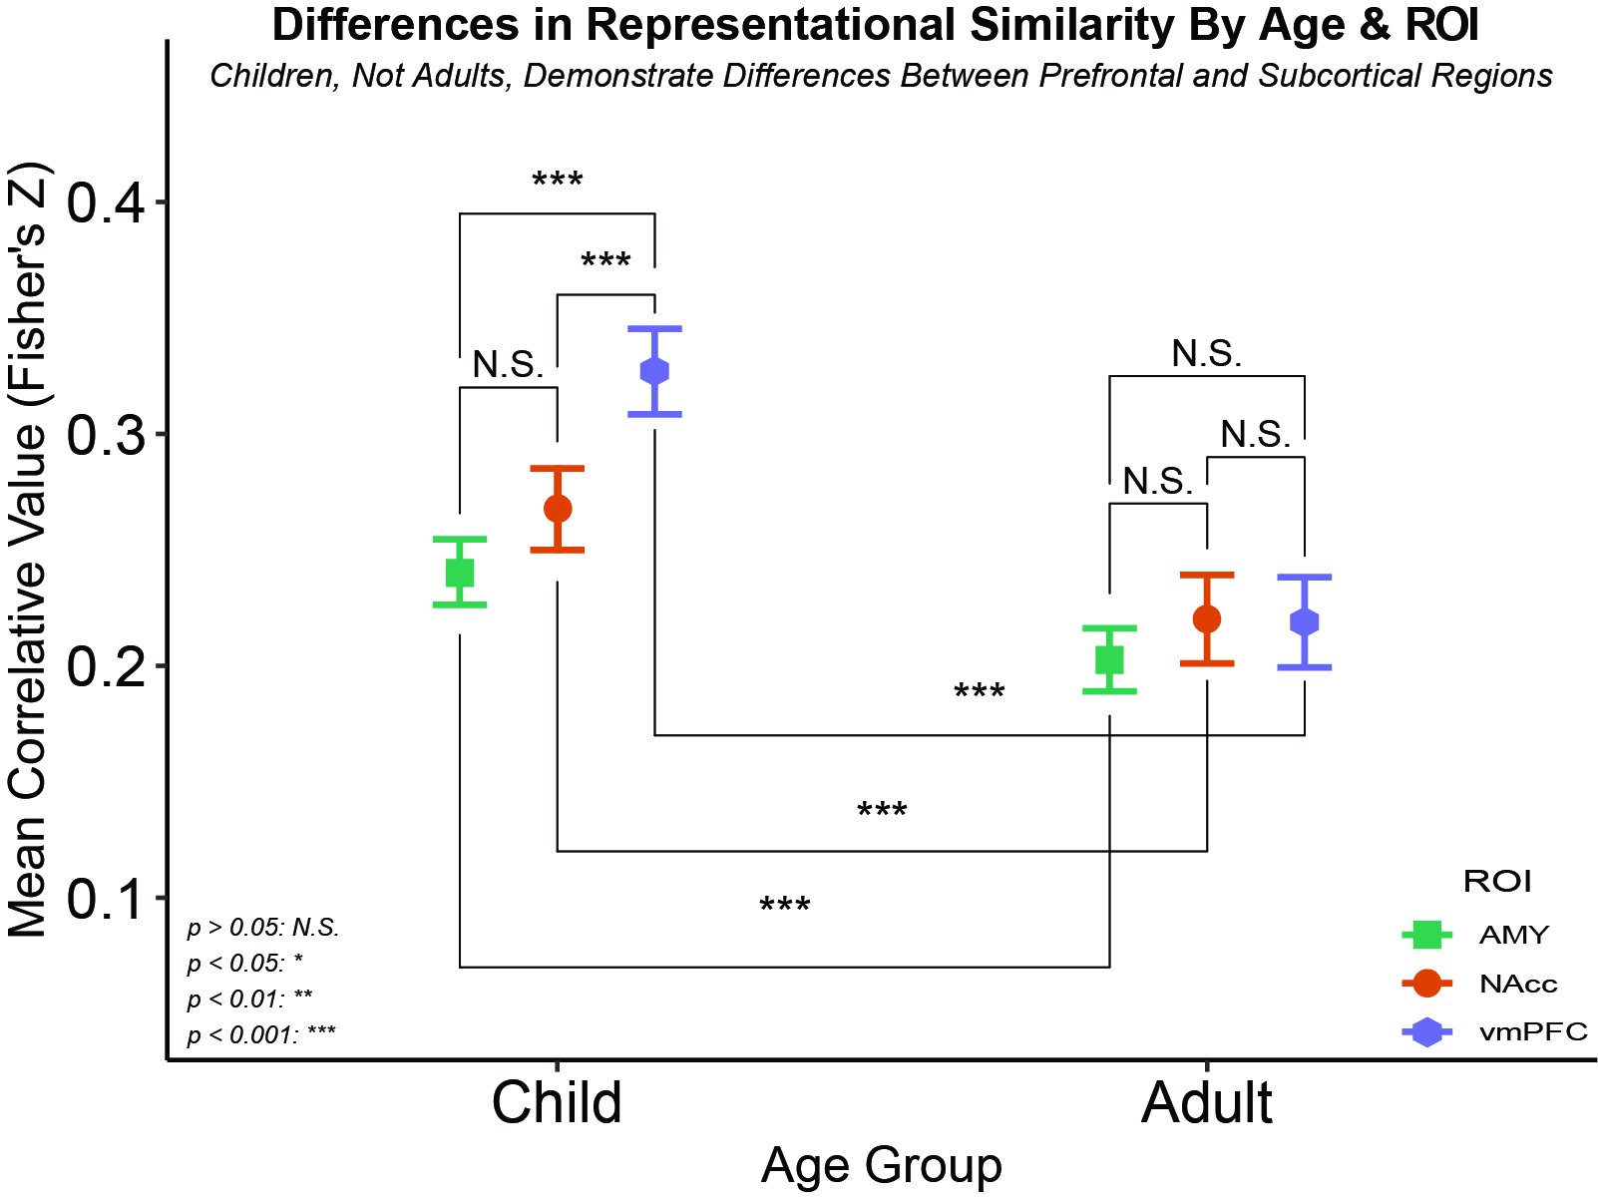
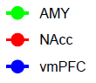
Supported
More Similar
Adults demonstrated no ROI differences while children demonstrated differences between the vmPFC and each subcortical structure
Less Similar
vmPFC
NAcc
Amyg
Notes:
We again have our age groups on the X axis
on the y axis we have our correlative values,
And our ROIs are represented in the legend, with the amygdala being sort of turquoise, the nucleus accumbens being orange, and the vmPFC being purple.
And lastly, we now have ROI as our moderator with a little reminder of where each region is located on the left.

Slide 65
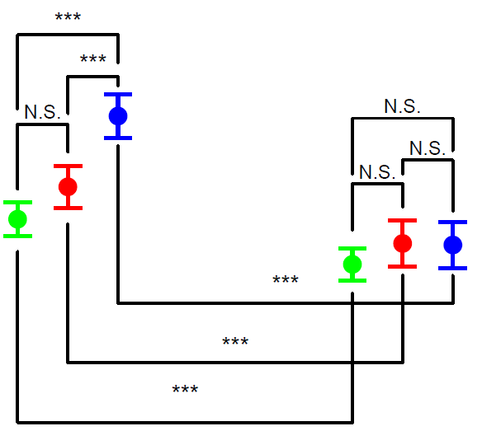
Supported
More Similar
Adults demonstrated no ROI differences while children demonstrated differences between the vmPFC and each subcortical structure
Less Similar
vmPFC
NAcc
Amyg
Notes:
We again see little pattern similarity among adults by region

Slide 66
Supported
More Similar
Adults demonstrated no ROI differences while children demonstrated differences between the vmPFC and each subcortical structure
Less Similar
vmPFC
NAcc
Amyg
Notes:
We again see little pattern similarity among adults by region

Slide 67
Supported
More Similar
Adults demonstrated no ROI differences while children demonstrated differences between the vmPFC and each subcortical structure
Less Similar
vmPFC
NAcc
Amyg
Notes:
However, children show far greater pattern similarity in the vmPFC than they do subcortical regions

Slide 68
Summary
Children did demonstrate pattern similarity across stimuli than adults
1
Children demonstrated greater pattern similarity than adults in positive and negative but not neutral representations.
2
Children vmPFCs demonstrated greater pattern similarity than subcortical regions; adults did not
3
COMPLEXITY
DIFFERENTIATION
MEANING MAKING
Notes:
[Read the slide]

Slide 69

Implications
We may be observing representational phenomena reflective of normative affective development, but future research is needed to say for sure.
This is the first application of representational similarity approaches on a developmental population using naturalistic stimuli to document affective differences.

Slide 70
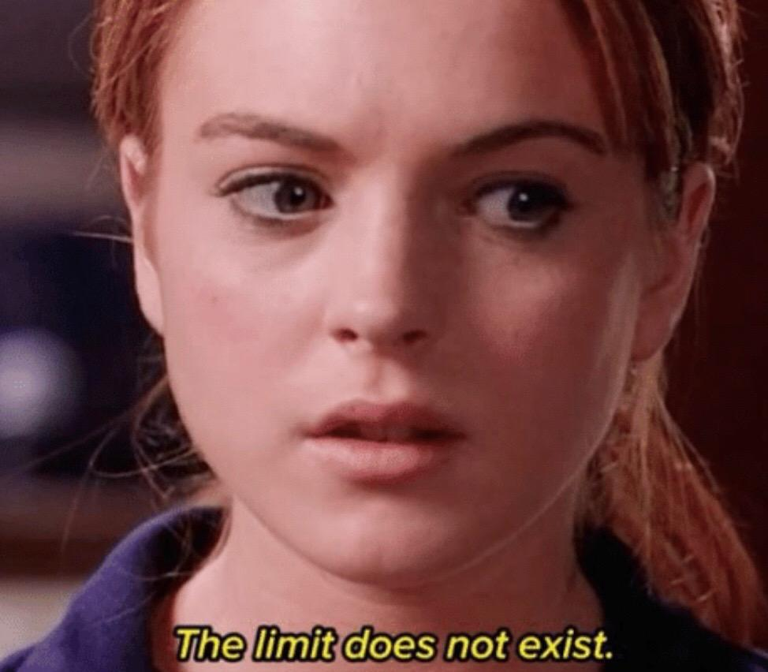

Limitations of Our Approach
Relatively small sample size
Lack of adolescent representation
Cannot comment on contents of representations
Notes:
But of course, this study should really only be thought of as a very limited first pass in this space. First we have a fairly small sample for the span of development we are trying to capture. It’s also notable we have a massive gap in our sample, in that we have no adolescents
which might really complicate these relatively simplistic theories We also cannot make the claim that these representations are definitively affecting downstream processes Because we only examined passive viewing, we did not ask them to make decisions and we cannot be 100% sure about the contents of these representations But we have some work in the pipeline that I’m very excited and that will address these limitations

Slide 71
Conclusions
Differences in neural patterns of affective information have been observed between children and adults.
Naturalistic stimuli can be used to observe these differences.
Such an approach may be of interest to researchers interested in how representations can affect downstream outcomes
Notes:
Evaluative vs integrative
Hit home more on the naturalistic benefits as well
Kids struggle with traditional paradigms
Explain the upstream thing

Slide 72








Special Thanks to my co-authors:
Chelsea Helion
Lindsey Tepfer
Nicole Henninger
Vishnu Murty
Susan Perlman
… and my lab mates:
Joy Ham
Ginny Ulichney
Helen Schmidt

Slide 73


